Slide 1
The IoT World Forum (IoTWF) Standardized Architecture
In 2014, the IoTWF architectural committee (led by Cisco, IBM, Rockwell Automation, and others) published a seven- layer IoT architectural reference model.
IoTWF provides a way of visualizing IoT from a technical perspective.
Each of the seven layers is broken down into specific functions, and security encompasses the entire model.

Slide 2
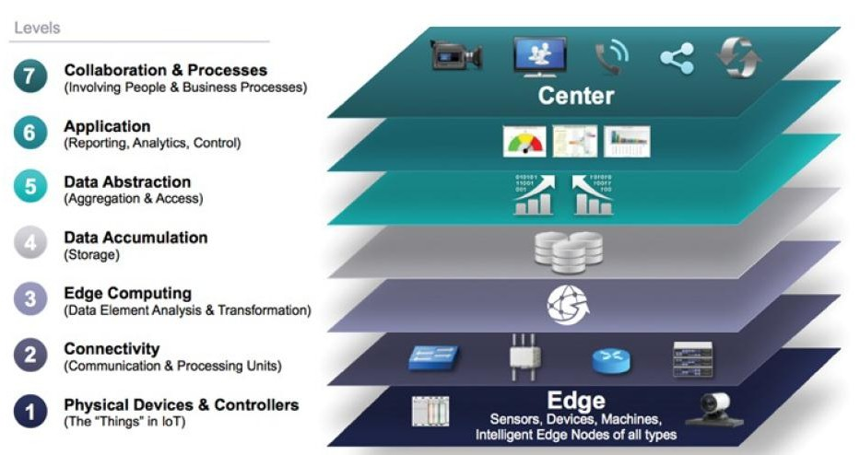
Figure 2.2 : IoT Reference Model Published by the IoT World Forum

Slide 3
Using IOTWF reference model, we are able to achieve the following:
Decompose the IoT problem into smaller parts
Identify different technologies at each layer and how they relate to one another
Define a system in which different parts can be provided by different vendors
Have a process of defining interfaces that leads to interoperability
Define a tiered security model that is enforced at the transition points between levels

Slide 4
Smart Watch → Mobile → Internet→Cloud→Processing(BDA) → Pie Chart/Bar Graph→ Doctor
Layer 1: Physical Devices and Controllers Layer
This layer is home to the “things” in the Internet of Things including the various endpoint devices and sensors that send and receive information.
The size of these “things” can range from almost microscopic sensors to giant machines in a factory.
Their primary function is generating data and being capable of being queried and/or controlled over a network.

Slide 5
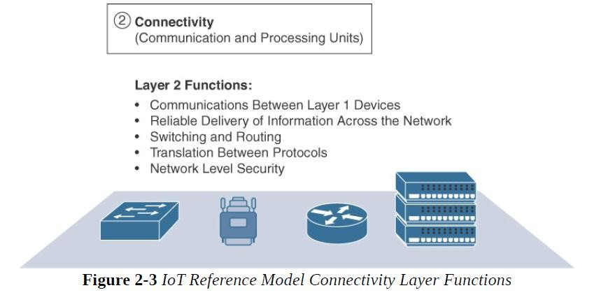
Smart Watch → Mobile → Internet→Cloud→Processing(BDA) → Pie Chart/Bar Graph→ Doctor
Layer 2: Connectivity Layer
The focus is on connectivity.
The most important function of this IoT layer is the reliable and timely transmission of data.

Slide 6
Smart Watch → Mobile → Internet→Cloud→Processing(BDA) → Pie Chart/Bar Graph→ Doctor
Layer 3: Edge Computing(Data analysis and transformation)
Edge computing is often referred to as the “fog” layer
At this layer, the emphasis is on data reduction and converting network data flows into information that is ready for storage and processing by higher layers.
One of the basic principles of this reference model is that information processing is initiated as early and as close to the edge of the network as possible.

Slide 7
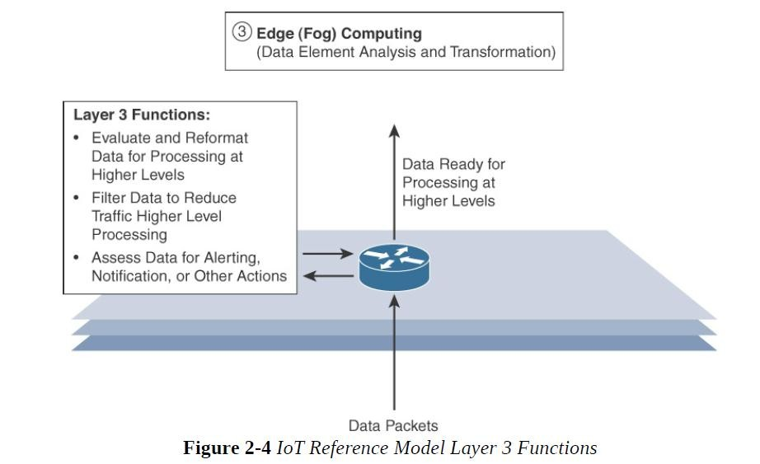

Slide 8
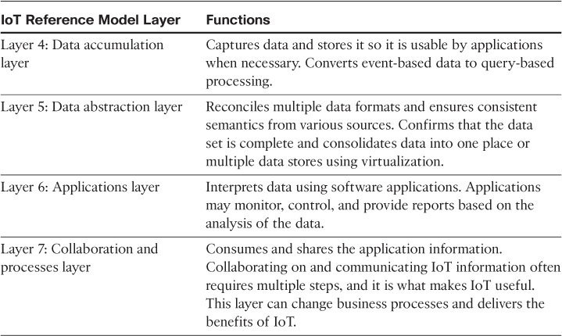
Upper Layers: Layers 4–7 The upper layers deal with handling and processing the IoT data generated by the bottom layer.
Data Protection and security
Filtering,selection, projection etc..

